Slide 1
L6 Group 4 – Pitch 6
Oliver Chamberlain
Daniel Jamieson
Ross Warren
Douglas Simpson

Slide 2
The brief
Game of emergence
Multiple Solutions
Single player
PC
IMAGE OF GAME

Slide 3
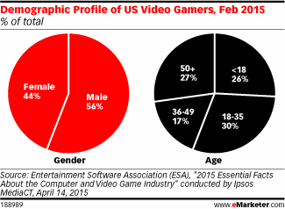
Demographic/Psychographic
Males
Aged 15-25
Students
Management/ City simulation game

Slide 4
Monster Miner
Colony Simulation
Resource Management
Overhead Camera
Survive and Expand
INSERT IMAGE OF MONSTERS

Slide 5
Colonists
Hunter
Crafter
Gatherer
INSERT IMAGE OF COLONISTS

Slide 6
Main loop
Hunt
Gather
Build/Craft
GIF OF MAIN GAME LOOP

Slide 7
Buildings
Barracks
Blacksmith
Stockpile/Granary
Armoury
House
GIF OF BUILDING PLACEMENT AND USE

Slide 8
Crafting loop
Gather
Craft
Equip
GIF OF CRAFTING LOOP

Slide 9
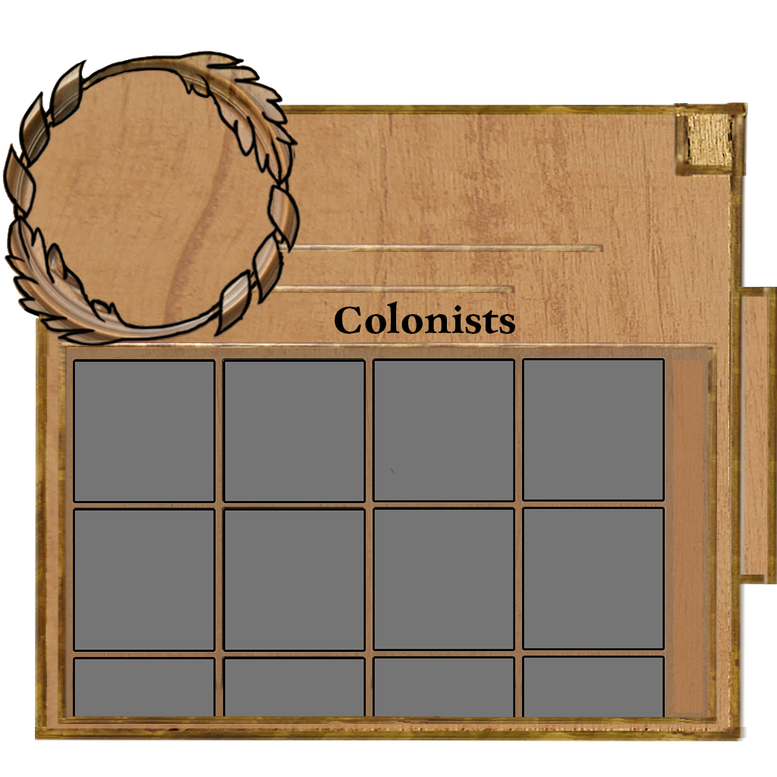
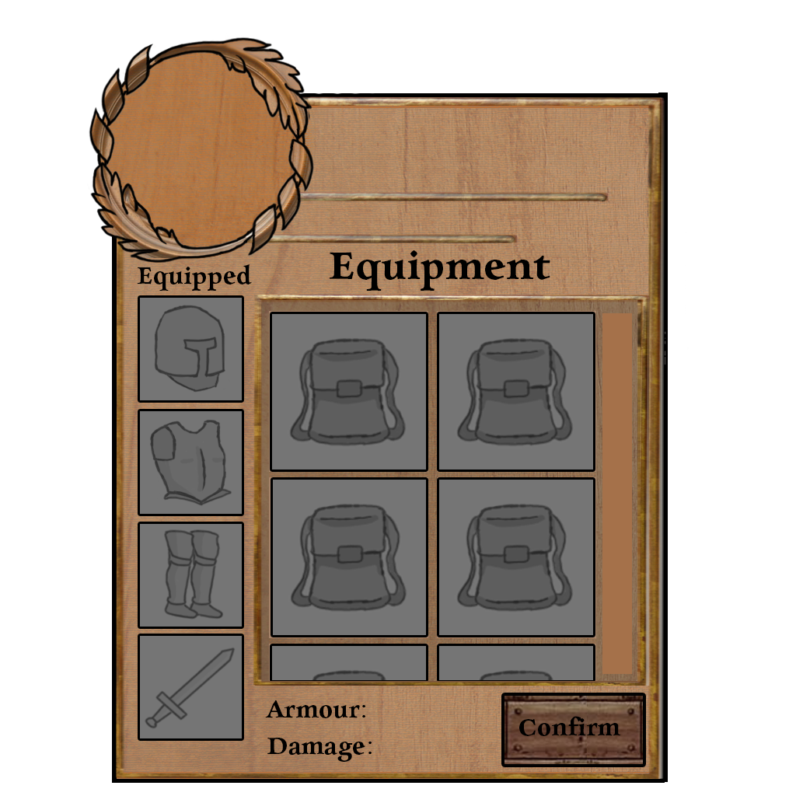
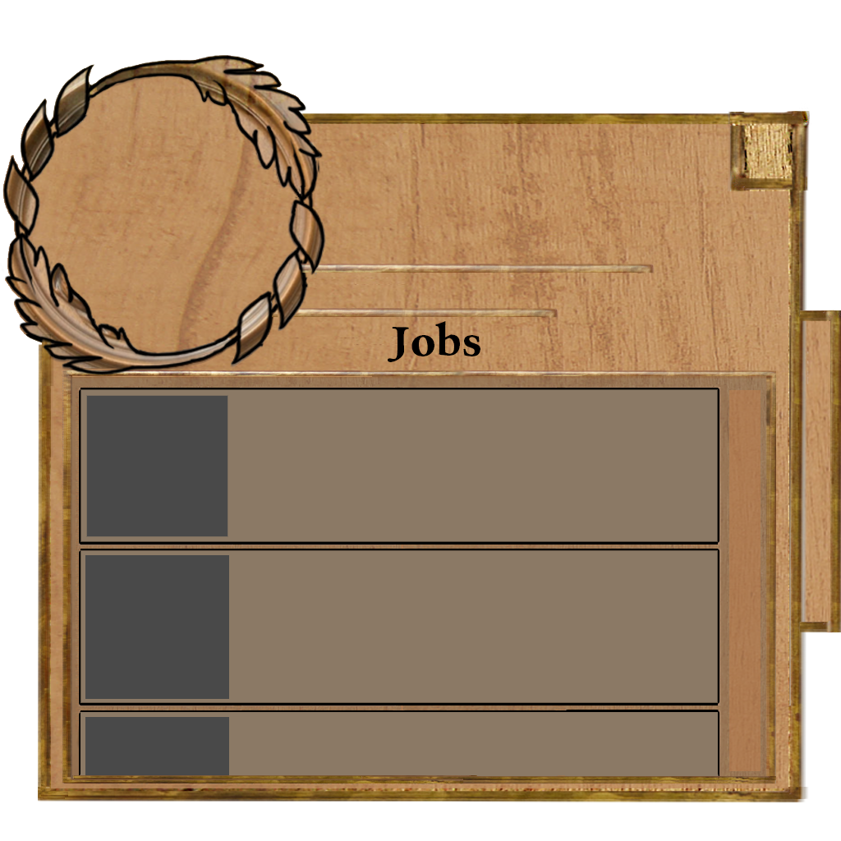
Art Assets (User Interface)
INSERT IMAGE OF MAIN BAR

Slide 10
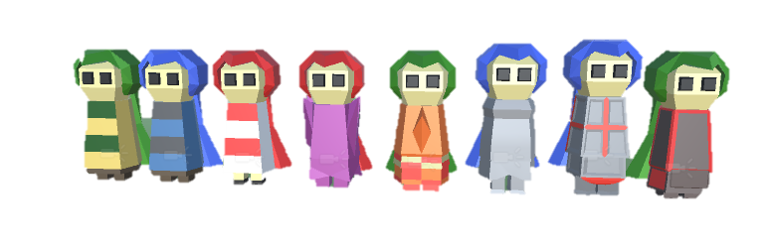
Art Assets (Colonists)

Slide 11
Art Assets (Buildings)
INSERT USED BUILDINGS

Slide 12
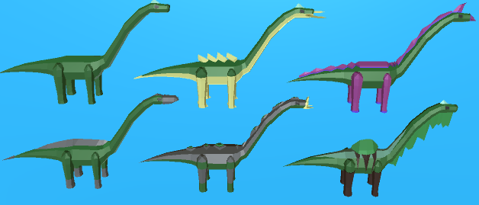
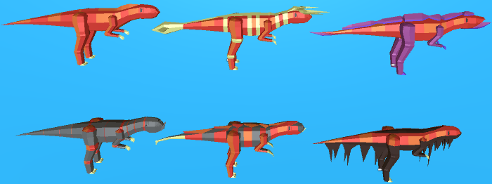
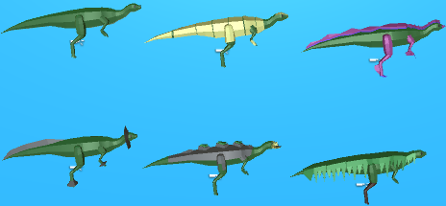
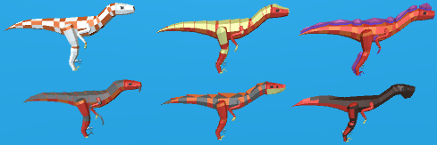
Art Assets (Monsters)

Slide 13
Questions?

